Slide 1


Python & JSON Workshop
Preliminary version V0.9, latest version
Yvan Rooseleer Belgian IT Academy Support Center BiASC Odisee University Of Applied Sciences Brussels
IPD Week 25 February 2021
Notes:
METADATA
Author: Yvan Rooseleer
Speaker's email: Yvan Rooseleer yvan.rooseleer@biasc.be
Creation Date: 6 February 2021
Based on document: https://docs.google.com/document/d/1jWNaW4OMkcCu1wnXZbQSMKxy23dIcq6ds4CBnEEXe0Q/edit?usp=sharing
Session name:
Part 1: DevNet Associate: Filtering JSON Data, 25 FEB 2021, 16:00
Part 2: DevNet Associate: Generating JSON Data, 25 FEB 2021, 17:00
Session description:
Part 1: DevNet Associate: Filtering JSON Data
Description: This part covers some aspects of the DevNet Associate course. Join to learn how to interpret JSON data coming from Webex Teams API, DNAC API, Docker inspect, Ansible.
Part 2: DevNet Associate: Generating JSON Data
Description: This part covers some aspects of the DevNet Associate course. Join to learn how to generate JSON data for Webex Teams API, IP Devices and Network Services from a source in the Excel format.
Level: Intermediate
Prerequisites
Basic understanding of:
-- Python scripting and programming
-- Data modelling: YANG
-- Data formats: JSON, YAML, XML
-- Secure Shell/ SSH
-- HTTPS/ SSL/ TLS
-- Webex APIs
-- Restconf APIs
-- Ansible Playbooks
-- Docker

Slide 2
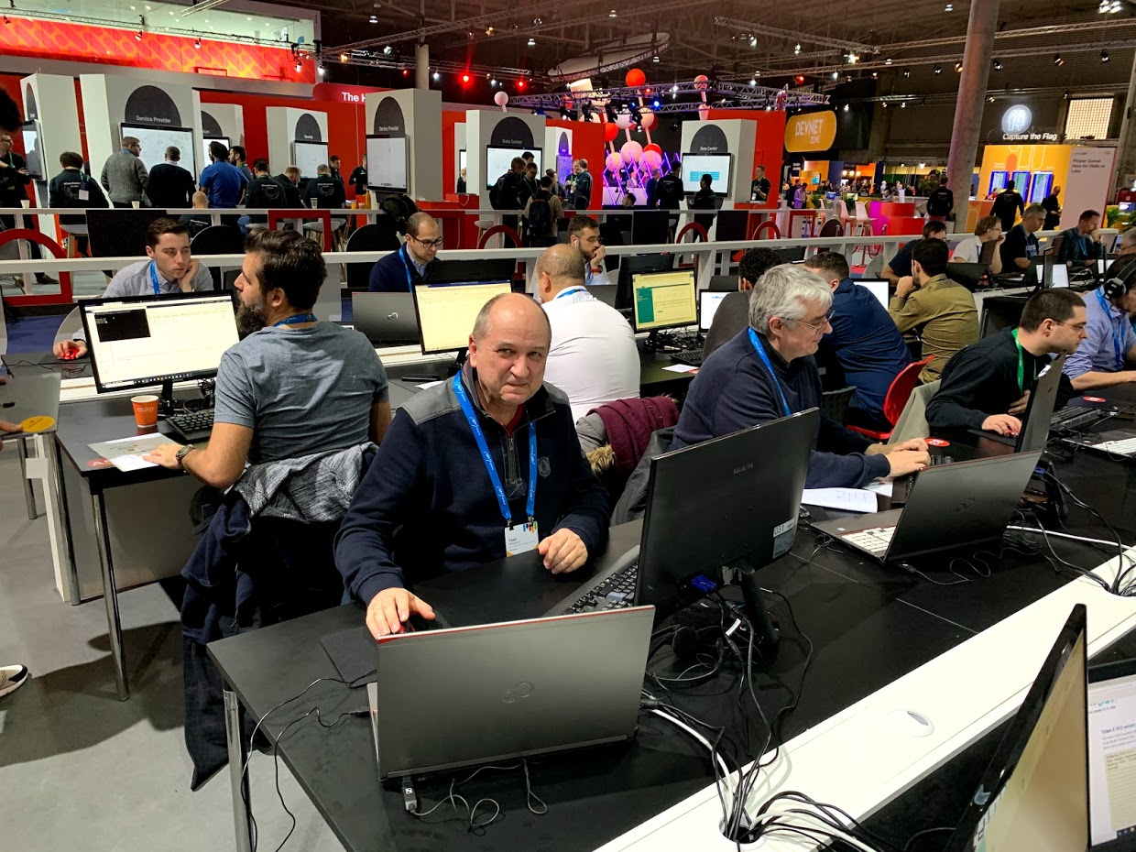
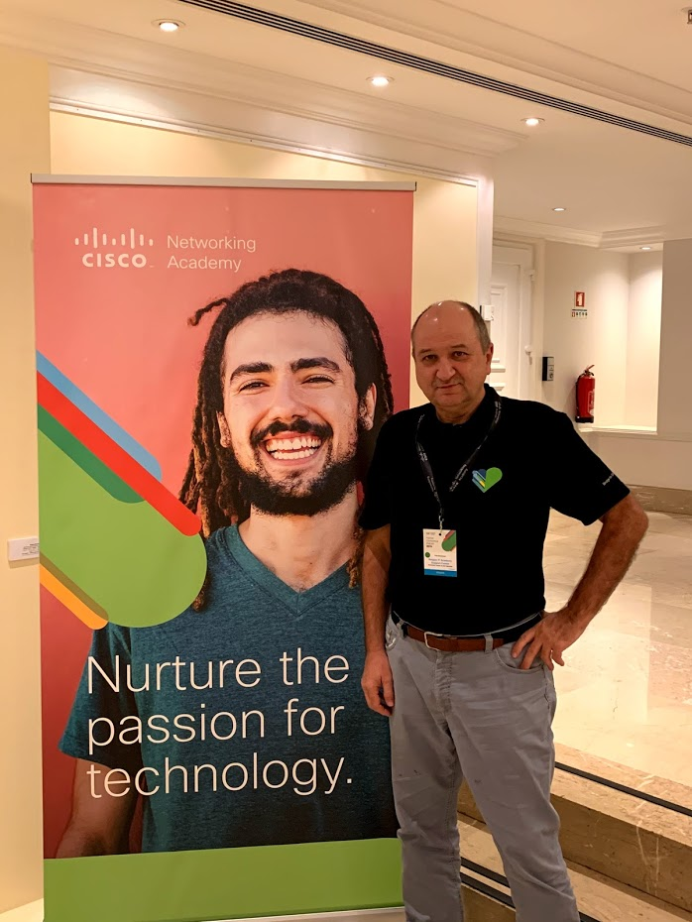
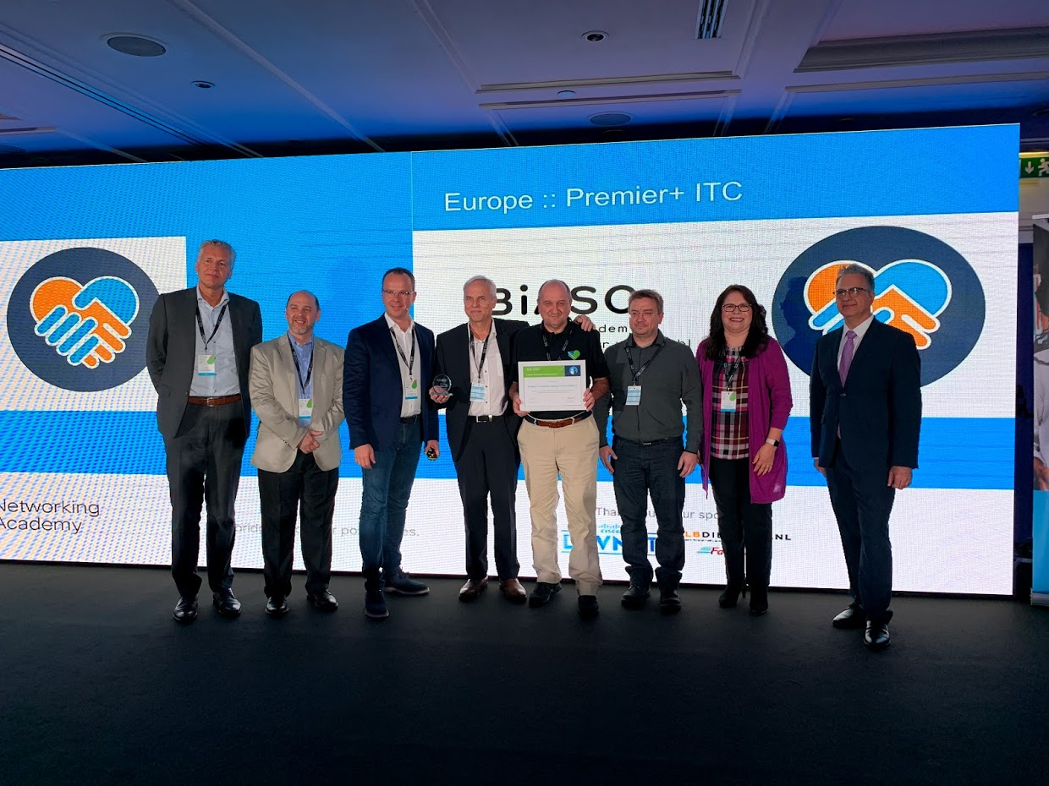
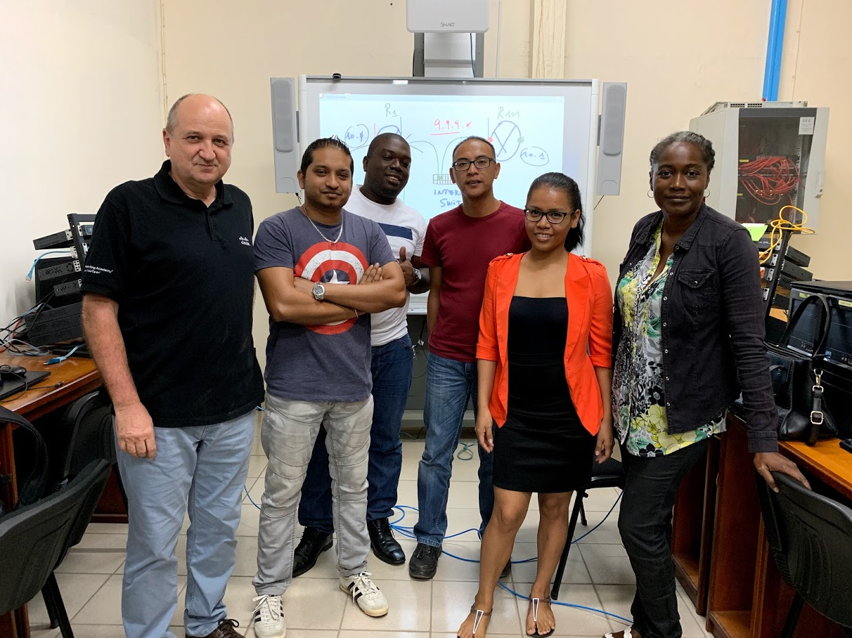
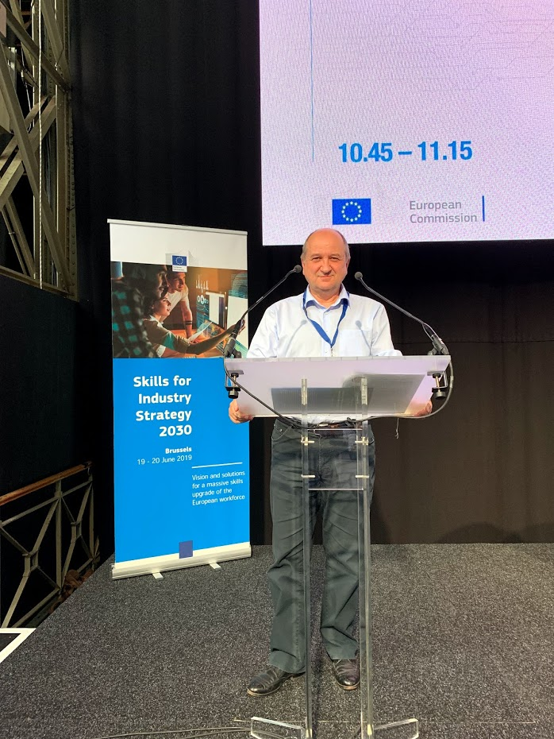

Yvan Rooseleer Brussels, Belgium Senior Lecturer Odisee, Brussels - University of Applied Sciences BiASC Country Manager - Instructor Trainer > 10.000 h Software Development Database Development > 10.000 h Database Administration IT Infrastructure Management > 10.000 h Network & Security Management Problem-based challenges

Slide 3
Agenda
Practical examples with Python & JSON
Managing Response Data in JSON format
RESTCONF
Cisco DNA Center
Webex
Ansible
Docker
Processing data from Excel spreadsheets
Transforming data into a JSON tree structure
Notes:
A companion document exists that provides you with background and references, you can find it here
The data files for the practical examples and exercises are here.

Slide 4
Parts of the Workshop
Part 1: DevNet Associate: Filtering JSON Data
Description: This part covers some aspects of the DevNet Associate course. Join to learn how to interpret JSON data coming from Webex Teams API, DNAC API, Docker inspect, Ansible.
Part 2: DevNet Associate: Generating JSON Data
Description: This part covers some aspects of the DevNet Associate course. Join to learn how to generate JSON data for Webex Teams API, IP Devices and Network Services from a source in the Excel format. --- The examples in this workshop are based on the Emerging Technology Workshops and on the recent DevNet Associate Course from Cisco Networking Academy Course Catalog.
Notes:
Cisco Networking Academy Courses
DevNet Associate 1.0
Emerging Technology Workshop: Experimenting with REST APIs using Webex Teams
Emerging Technology Workshop: Model-Driven Programmability
Emerging Technology Workshop: Network Programmability with Cisco APIC-EM, no longer supported

Slide 5
Useful Coding Skills for NetAcad Instructors
If you are teaching the DevNet Associate Course or the Emerging Technology Courses, the following Python coding skills are relevant:
Constructing API Calls using Python
URI, URL
Authentication & Authorization
Managing JSON Exchange Data using Python
Response data
Data Types
Data Conversion
Using existing Python Code and Libraries
Coding from scratch is not a requirement
This workshop focuses on managing JSON Data
Notes:
NetAcad Instructors should be familiar with Python scripting, because using a programming language offers more generic skills than using a GUI (as in DNA Center).

Slide 6
Part 1
Part 1: DevNet Associate: Filtering JSON Data
Description: This part covers some aspects of the DevNet Associate course. Join to learn how to interpret JSON data coming from Webex Teams API, DNAC API, Docker inspect, Ansible.
Part 2: DevNet Associate: Generating JSON Data
Description: This part covers some aspects of the DevNet Associate course. Join to learn how to generate JSON data for Webex Teams API, IP Devices and Network Services from a source in the Excel format.
Notes:
Cisco Networking Academy Courses
DevNet Associate 1.0
Emerging Technology Workshop: Experimenting with REST APIs using Webex Teams
Emerging Technology Workshop: Model-Driven Programmability
Emerging Technology Workshop: Network Programmability with Cisco APIC-EM, no longer supported

Slide 7
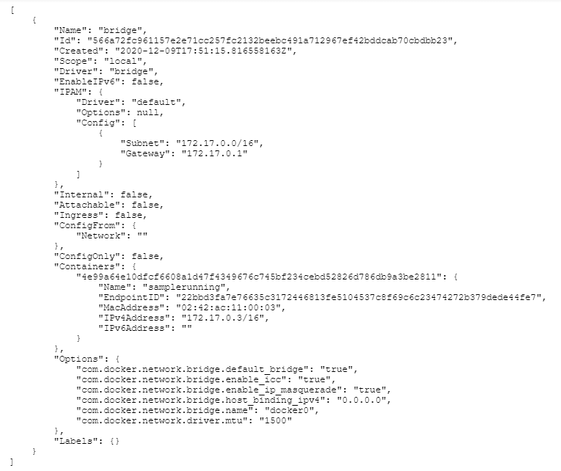
Problem Statement
Response Data in JSON Format
Machine readable
Hierarchical Tree structure
Overwhelming for humans
Notes:
As a NetAcad Instructor or as an IT Professional it may be necessary to look for important information (like IP addresses) in JSON format.
Left side
Output from the following Docker command $ docker network inspect bridge

Slide 8
Example 1: JSON RESPONSE DATA
RESTCONF URL Example/ Virtual Router https://192.168.56.101/restconf/data/ietf-interfaces:interfaces Authentication header is needed
Raw Response (serialized, machine readable)
{"ietf-interfaces:interfaces": {"interface": [{"name": "GigabitEthernet1", "description": "VBox", "type": "iana-if-type:ethernetCsmacd", "enabled": true, "ietf-ip:ipv4": {"address": [{"ip": "192.168.56.101", "netmask": "255.255.255.0"}]}, "ietf-ip:ipv6": {}}, {"name": "Loopback9", "description": "999", "type": "iana-if-type:softwareLoopback", "enabled": true, "ietf-ip:ipv4": {"address": [{"ip": "10.9.9.9", "netmask": "255.255.255.0"}]}, "ietf-ip:ipv6": {}}]}}
Notes:
As a NetAcad Instructor or as an IT Professional it may be necessary to look for important information (like IP addresses) in JSON format.

Slide 9
Example 2: JSON RESPONSE DATA
DNA CENTER CLIENT HEALTH REQUEST
import requests
import json
# f-string is used for string formatting of request url # Authentication header is needed get_resp = requests.get(f"https://{host}/dna/intent/api/v1/client-health",
headers=headers, params=params)
RAW RESPONSE DATA FRAGMENT
{'response': [{'siteId': 'global', 'scoreDetail': [{'scoreCategory': {'scoreCategory': 'CLIENT_TYPE', 'value': 'ALL'}, 'scoreValue': 29, 'clientCount': 82, 'clientUniqueCount': 82, 'starttime': 1611071700000, 'endtime': 1611072000000}, {'scoreCategory': {'scoreCategory': 'CLIENT_TYPE', 'value': 'WIRED'}, 'scoreValue': 100, 'clientCount': 2, 'clientUniqueCount': 2, 'starttime': 1611071700000, 'endtime': 1611072000000, 'scoreList': [{'scoreCategory': {'scoreCategory': 'SCORE_TYPE', 'value': 'POOR'}, 'scoreValue': -1, 'clientCount': 0, 'clientUniqueCount': 0, 'starttime': 1611071700000, 'endtime': 1611072000000}, ...
Notes:
As a NetAcad Instructor or as an IT Professional it may be necessary to look for important information (like network health scores) in JSON format.

Slide 10
Example 3: JSON RESPONSE DATA
Webex API Call: https://api.ciscospark.com/v1/people/me
{"id":"Y2lzY29zcGFya...NlYzQ5NjI5MGY","emails":["Yvan.rooseleer@biasc.be"],"sipAddresses":[{"type":"personal-room","value":"838744612@biasc.webex.com","primary":false},{"type":"personal-room","value":"yvan.rooseleer@biasc.webex.com","primary":false},{"type":"cloud-calling","value":"Yvan.rooseleer@biasc.calls.webex.com","primary":true}],"displayName":"YvanRooseleer","nickName":"Yvan","firstName":"Yvan","lastName":"Rooseleer","avatar":"https://avatar-prod-us-east-2.webexcontent.com/Avtr~V1~e4d4112d-2548-4a47-810e-04fe64-a79b-49c5-823a-92cec494bb9c1d1de6~1600","orgId":"Y2lzY29zcGFyazovL3VzL09SR0FOSctODEwZS0wNGZlNDVlYTE4MWY","roles":["Y2lzY29zcGFya9hZG1pbg"],"licenses":["Y2lTQtNDExZS1hYThkLTA1MDI3N2Y3ZjdlOQ","Y2lzY29zcGFyazovL3VzL0xJQ0VOy53ZWJleC5jb20","Y2lzY29zcGFyazovL3VzL0xJQ0VOUxYmJlZTU2LWQwZmItNGFiNy1hMTYyLTlmNjQ2OGIyYmU5ZA","Y2lzYVOU0UvZTRkNDExMmQtMjU0OC00MWBiNDI4MmQ5NmY5NA","Y2lzYTJhNTNfZmlhc2Mud2ViZXguY29t","Y2lzYZWExODFmOkZTU18xYjcyOGZmOS03ZGU4LTRjYjctOTU0MC0yOTMyMGI1YTQyY2I","Y2lzY29zUtMDRmZTZ1ZWExODFmOkZUTV9mNWZkZTM1Zi00NzA0LTQ2MGEtODEwZi00YzVkMzUyNDFlNjk","Y2lzY29zcExODFmOkNHXzVkYjcwNjYyLWNmYTItNGFjZC04MZRlLTgwYjNiNWVkZjNlZA","Y2lzY29zcGFyazovL3jQ3MzgyOC1hOTgwLTQ3MmYtODE5ZC02YjZjY2UwOGU5MmI","Y2lzY29zcGFyazovLmOZZNU185ZWNhNzgxNC0zMzEzLTQ2NGYtOTY0Mi0wMjM5ODc1YmM5Zjg","Y2lzY29zcGFyazovLNDExMmQtMjU0OGE3NSZhNDNmLTBkYmJhMjIyNzg3Zl9iaWFzYy53ZWJleC5jb20","Y2lMwMjFkLTgwYjctNDFiYi1iZThhLWM0YjFiZjcyNTE4YV9iaWFzYy53ZWJleC5jZ20","Y2lzY29zcGFyazovZ3V0YTQ3LTgxMGUtMDRmZTQ1ZWExODFmOk1kYmFiMDcxYmY0NA","Y2lzY29zcGFyazovL3VzL0xJQ0VOUXzNZMDU3N2RiLTFjOGItNDQ4My1hMTBjLzYy53ZWJleC5jb20"],"created":"2016-12-23T08:38:22.877Z","lastModified":"2021-01-26T17:55:07.662Z","lastActivity":"2021-01-26T17:54:24.481Z","status":"active","invitePending":false,"loginEnabled":true,"type":"person","trainSiteNames":["biasc.webex.com"]}
Notes:
As a NetAcad Instructor or as an IT Professional it may be necessary to look for important information (like creation date) in JSON format.

Slide 11
Example 4: JSON RESPONSE DATA
$ ansible webservers -m gather_facts --tree ./tmp_facts URL for the complete response file: https://docs.google.com/document/d/1Z7wO5r8XaBirxXo06CmC8a6r5cCMezQQqUOcHxXhCyk/edit?usp=sharing Partial Output (with some response data highlighted) {"ansible_facts": {"ansible_all_ipv4_addresses": ["192.0.2.1", "192.0.2.2", "192.0.2.3", "192.0.2.4", "192.0.2.5", "10.0.2.15", "172.17.0.1"], "ansible_all_ipv6_addresses": ["fe80::9002:c8ff:fee8:bb09", "fe80::3c67:a5ff:fe17:e4cf", "fe80::a00:27ff:fee9:3de6", "fe80::42:3ff:fef6:9477"], "ansible_apparmor": {"status": "enabled"}, "ansible_architecture": "x86_64", "ansible_bios_date": "12/01/2006", "ansible_bios_version": "VirtualBox", "ansible_cmdline": {"BOOT_IMAGE": "/boot/vmlinuz-5.4.0-37-generic", "quiet": true, "ro": true, "root": "UUID=fb261367-cf98-4bce-b682-42b3de0a8ab9", "vga": "792", "zswap.enabled": "1"}, "ansible_date_time": {"date": "2021-01-20", "day": "20", "epoch": "1611160850", "hour": "16", "iso8601": "2021-01-20T16:40:50Z", "iso8601_basic": "20210120T164050181658", "iso8601_basic_short": "20210120T164050", "iso8601_micro": "2021-01-20T16:40:50.181774Z", "minute": "40", "month": "01", "second": "50", "time": "16:40:50", "tz": "UTC", "tz_offset": "+0000", "weekday": "Wednesday", "weekday_number": "3", "weeknumber": "03", "year": "2021"}, "ansible_default_ipv4": {"address": "10.0.2.15", "alias": "enp0s3", "broadcast": "10.0.2.255", "gateway": "10.0.2.2", "interface": "enp0s3", "macaddress": "08:00:27:e9:3d:e6", "mtu": 1500, "netmask": "255.255.255.0", "network": "10.0.2.0", "type": "ether"}, "ansible_default_ipv6": {}, … , "ansible_distribution": "Ubuntu", "ansible_distribution_file_parsed": true, "ansible_distribution_file_path": "/etc/os-release", "ansible_distribution_file_variety": "Debian", "ansible_distribution_major_version": "20", "ansible_distribution_release": "focal", "ansible_distribution_version": "20.04", "ansible_dns": {"nameservers": ["127.0.0.53"], … , "ansible_nodename": "labvm", "ansible_os_family": "Debian", "ansible_pkg_mgr": "apt", "ansible_proc_cmdline": {"BOOT_IMAGE": "/boot/vmlinuz-5.4.0-37-generic", "quiet": true, "ro": true, "root": "UUID=fb261367-cf98-4bce-b682-42b3de0a8ab9", "vga": "792", "zswap.enabled": "1"}, "ansible_processor": ["0", "GenuineIntel", "Intel(R) Core(TM) i7-7600U CPU @ 2.80GHz", "1", "GenuineIntel", "Intel(R) Core(TM) i7-7600U CPU @ 2.80GHz"], "ansible_processor_cores": 2, "ansible_processor_count": 1, "ansible_processor_threads_per_core": 1, "ansible_processor_vcpus": 2, "ansible_product_name": "VirtualBox", "ansible_product_serial": "NA", "ansible_product_uuid": "NA", "ansible_product_version": "1.2", "ansible_python": {"executable": "/usr/bin/python3", "has_sslcontext": true, "type": "cpython", "version": {"major": 3, "micro": 2, "minor": 8, "releaselevel": "final", "serial": 0}, "version_info": [3, 8, 2, "final", 0]}, "ansible_python_version": "3.8.2", "ansible_real_group_id": 900, "ansible_real_user_id": 900, "ansible_selinux": {"status": "disabled"}, "ansible_selinux_python_present": true, "ansible_service_mgr": "systemd", … , "ipv6": [{"address": "fe80::3c67:a5ff:fe17:e4cf", "prefix": "64", "scope": "link"}], "macaddress": "3e:67:a5:17:e4:cf", "mtu": 1500, "promisc": true, "speed": 10000, "timestamping": ["tx_software", "rx_software", "software"], "type": "ether"}, "ansible_virtualization_role": "guest", "ansible_virtualization_type": "virtualbox", "discovered_interpreter_python": "/usr/bin/python3", "gather_subset": ["all"], "module_setup": true}, "changed": false, "deprecations": [], "warnings": []}
Notes:
As a NetAcad Instructor or as an IT Professional it may be necessary to look for important information (like IP addresses) in JSON format.
URL for the complete response file: https://docs.google.com/document/d/1Z7wO5r8XaBirxXo06CmC8a6r5cCMezQQqUOcHxXhCyk/edit?usp=sharing

Slide 12
Example 5: JSON RESPONSE DATA
$ docker image inspect ubuntu
Output (with some response data highlighted) [{"Id": "sha256:9140108b62dc87d9b278bb0d4fd6a3e44c2959646eb966b86531306faa81b09b", "RepoTags": ["ubuntu:latest"], "RepoDigests": ["ubuntu@sha256:bc2f7250f69267c9c6b66d7b6a81a54d3878bb85f1ebb5f951c896d13e6ba537"], "Parent": "", "Comment": "", "Created": "2020-09-25T22:34:30.295807036Z", "Container": "1046a5d685aef5c37d1829040ca8083b94e4c069ca4963f4b16a6ade2e077b06", "ContainerConfig": {"Hostname": "1046a5d685ae", "Domainname": "", "User": "", "AttachStdin": false, "AttachStdout": false, "AttachStderr": false, "Tty": false, "OpenStdin": false, "StdinOnce": false, "Env": ["PATH=/usr/local/sbin:/usr/local/bin:/usr/sbin:/usr/bin:/sbin:/bin"], "Cmd": ["/bin/sh", "-c", "#(nop) ", "CMD [\"/bin/bash\"]"], "ArgsEscaped": true, "Image": "sha256:4ff2090064e7e38688bce713d50f3202d227b3c89fecea1434271c912ccd47e0", "Volumes": null, "WorkingDir": "", "Entrypoint": null, "OnBuild": null, "Labels": {}}, "DockerVersion": "18.09.7", "Author": "", "Config": {"Hostname": "", "Domainname": "", "User": "", "AttachStdin": false, "AttachStdout": false, "AttachStderr": false, "Tty": false, "OpenStdin": false, "StdinOnce": false, "Env": ["PATH=/usr/local/sbin:/usr/local/bin:/usr/sbin:/usr/bin:/sbin:/bin"], "Cmd": ["/bin/bash"], "ArgsEscaped": true, "Image": "sha256:4ff2090064e7e38688bce713d50f3202d227b3c89fecea1434271c912ccd47e0", "Volumes": null, "WorkingDir": "", "Entrypoint": null, "OnBuild": null, "Labels": null}, "Architecture": "amd64", "Os": "linux", "Size": 72875723, "VirtualSize": 72875723, "GraphDriver": {"Data": {"LowerDir": "/var/lib/docker/overlay2/5d66f43ef0d92430a195045c4715ff3d49ee88ccb0bb7f6e69ccc5d60fde0ece/diff:/var/lib/docker/overlay2/0b75d53292ccb20230879e49c7fe6eea157addb083d414ba3d0485959cd35086/diff", "MergedDir": "/var/lib/docker/overlay2/c3bab8487f590bfd66e53db0b1902ab5a8b8fbfa1f02cfc3b4f0f9fa25158f2d/merged", "UpperDir": "/var/lib/docker/overlay2/c3bab8487f590bfd66e53db0b1902ab5a8b8fbfa1f02cfc3b4f0f9fa25158f2d/diff", "WorkDir": "/var/lib/docker/overlay2/c3bab8487f590bfd66e53db0b1902ab5a8b8fbfa1f02cfc3b4f0f9fa25158f2d/work"}, "Name": "overlay2"}, "RootFS": {"Type": "layers", "Layers": ["sha256:d42a4fdf4b2ae8662ff2ca1b695eae571c652a62973c1beb81a296a4f4263d92", "sha256:90ac32a0d9ab11e7745283f3051e990054616d631812ac63e324c1a36d2677f5", "sha256:782f5f011ddaf2a0bfd38cc2ccabd634095d6e35c8034302d788423f486bb177"]}, "Metadata": {"LastTagTime": "0001-01-01T00:00:00Z"}}]
Notes:
As a NetAcad Instructor or as an IT Professional it may be necessary to look for important information (like creation date) in JSON format.
Output from the following Docker command $ docker image inspect ubuntu
--
Definitely, this is information that needs to be processed
---
Here is the complete docker response

Slide 13
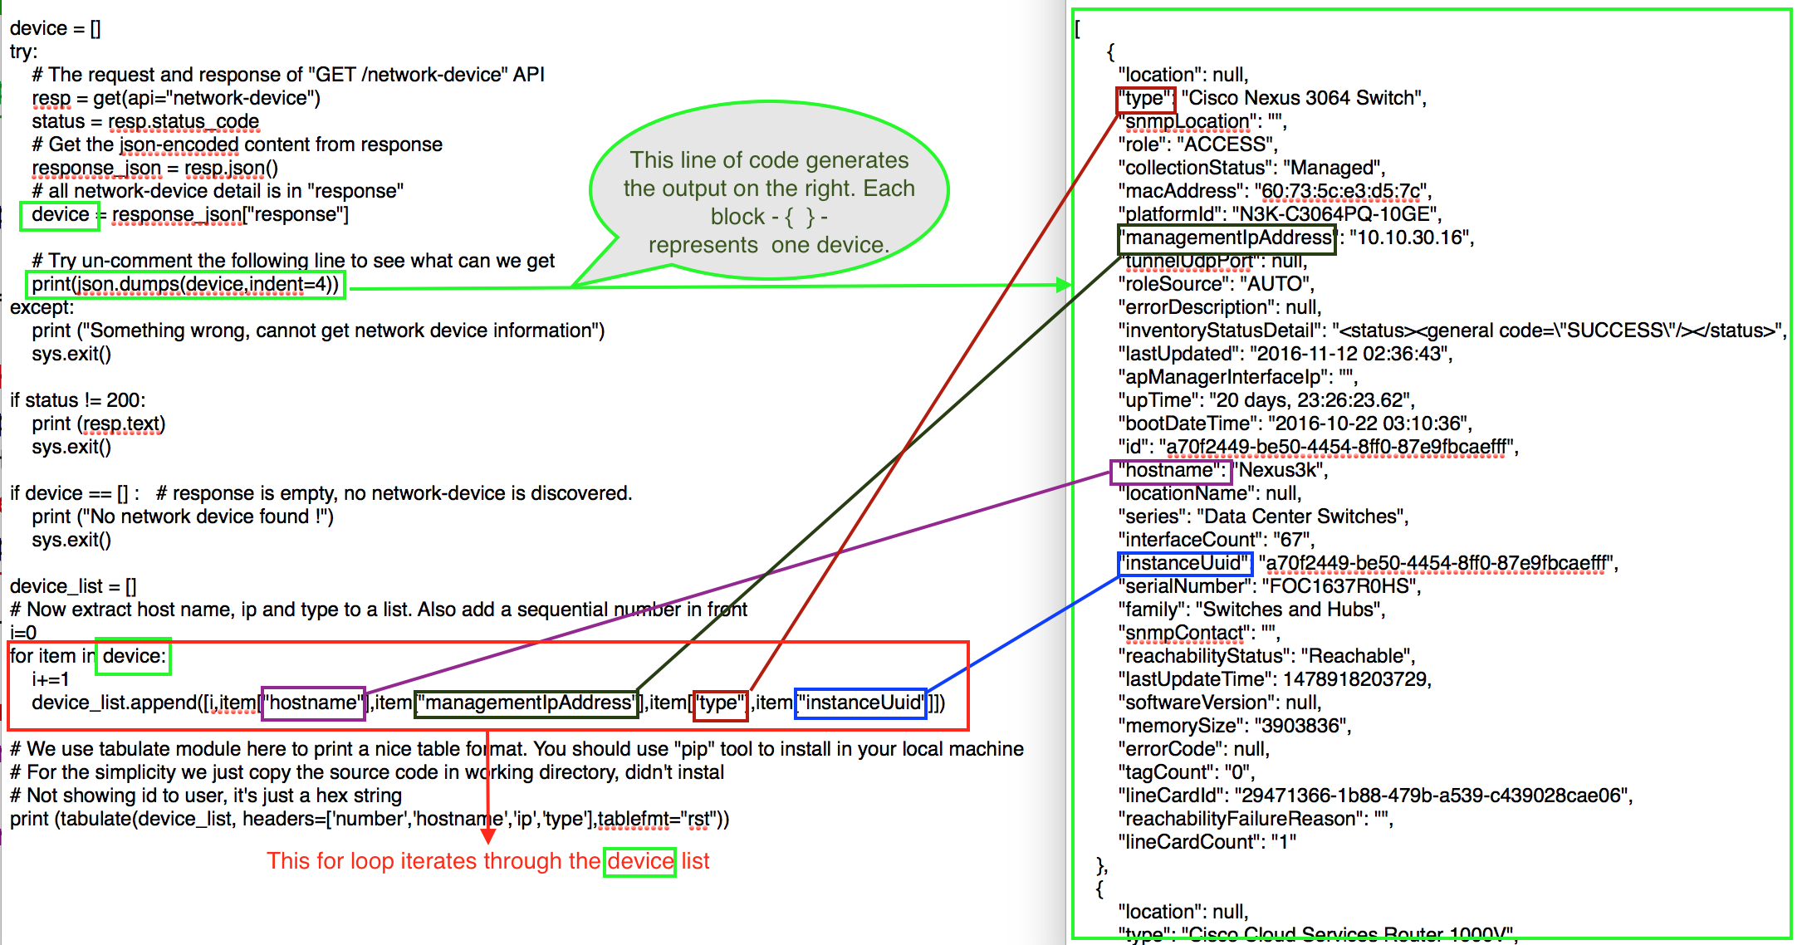
Example 6: JSON RESPONSE DATA
Notes:
As a NetAcad Instructor or as an IT Professional it may be necessary to experiment with Python scripts to filter or transfom JSON data.
Loops are regularly used to process response data: for item in device: ...
Source: https://developer.cisco.com/learning/lab/apic-em-basic/step/3

Slide 14
Tips for NetAcad Instructors and Students
Learn how to recognize data type
ietf_ipv4 = {'address': [{'ip': '192.168.56.101', 'netmask': '255.255.255.0'}]}
print(type(ietf_ipv4))
Output: <class 'dict'>
multiple_addresses = [{'ip': '192.168.56.101', 'netmask': '255.255.255.0'}, {'ip': '192.0.2.1', 'netmask': '255.255.255.252'} ]
print(type(multiple_addresses))
Output: <class 'list'>
Practice how to select or filter a data element
print(ietf_ipv4['address'][0]['ip']) ### first ip address selected
Output: 192.168.56.101
Use the keys() function to determine the keys used in the response

Slide 15
Tips for NetAcad Instructors and Students (2)
Practice how to transform data structures if necessary
json.dumps
json.loads
Only hands-on practice helps to grasp the rules and procedures
Experiment with the code
Don’t reinvent the wheel, don’t program from scratch
Import the necessary libaries in your Python scripts
import requests
import json
Learn from example scripts

Slide 16
Data Types & Data Conversion
The following elements are necessary to grasp for this workshop:
data type
str, int, boolean, dict, list and many more …
JSON = dict + list
dictionary: keys and values
{'hostname': 'CSR1kv'}
{'ip address': '192.168.56.100'}
list
['name', 'description', 'type', 'enabled', 'ietf-ip:ipv4', 'ietf-ip:ipv6']
import json
Convert to dict: json.loads
Convert to json (serialization): json.dumps
Notes:
---
Python Boolean => True False
Python Unknown => None
---
JSON Boolean => true false
JSON Unknown => null {} []
If you need information about Python built-in data type go here
To find out the data type of a variable atk, you can do the following:
print (type(atk))

Slide 17
Example A - Managing IP Addresses with Python
Python Data Structures for IP Addresses and Subnet Masks
Data Structures
single_address = {'ip': '192.168.56.101', 'netmask': '255.255.255.0'}
multiple_addresses = [{'ip': '192.168.56.101', 'netmask': '255.255.255.0'},
{'ip': '192.0.2.1', 'netmask': '255.255.255.252'} ]
ietf_ipv4 = {'address': [{'ip': '192.168.56.101', 'netmask': '255.255.255.0'}]}
Recognize Data Type
print(type(single_address))
<class 'dict'>
print(type(multiple_addresses))
<class 'list'>
print(type(ietf_ipv4))
<class 'dict'>
print(ietf_ipv4['address'][0]['ip'])
192.168.56.101
Notes:
JSON = dict + list
The data structure shown is close to the IETF YANG Model, but is is simplified: ietf_ipv4 = {'address': [{'ip': '192.168.56.101', 'netmask': '255.255.255.0'}]}

Slide 18
Example B - Managing IP Prefixes with Python
Python Data Structure for Network Prefixes and Subnet Masks (fragment)
prefix_subnet_masks = {
'/24': '255.255.255.0',
'/25': '255.255.255.128',
'/26': '255.255.255.192'
}
# example 1 -- using square brackets to select a key
subnet_mask_1 = prefix_subnet_masks['/24']
print(subnet_mask_1 )
output: 255.255.255.0
# example 2 -- using get() function to select a key
subnet_mask_2 = prefix_subnet_masks.get('/26')
print(subnet_mask_2)
output: 255.255.255.192
Notes:
If you want to access a dictionary item, you can do so by making a reference to its key inside a pair of square brackets (example 1) or by using the get() method (example 2)
More examples in the Workshop Document are here
QUOTATION MARKS
In a Python script you can use both double “ “' and ‘ ‘ single quotes.
A Python dict structure will typically use single quotes, while JSON uses double quotes.
This can be verified in https://jsonlint.com/

Slide 19
Exercise C - Managing IP Subnets with Python
Python Data Structure for Network Subnet Masks and Prefixes (fragment)
netmask_prefixes = {
'255.255.255.252': '/30'
,'255.255.255.248': '/29'
,'255.255.255.240': '/28'
,'255.255.255.224': '/27'
,'255.255.255.192': '/26'
,'255.255.255.128': '/25'
,'255.255.255.0' : '/24'
,'255.255.254.0' : '/23'
}
# Adapt to code fragment below to produce the output given
Prefix_1 = netmask_prefixes[“your answer”]
print(Prefix_1)
output: /27
Notes:
# Answer
Prefix_1 = netmask_prefixes[“255.255.255.224”]
print(Prefix_1 )
# outputs: /27

Slide 20
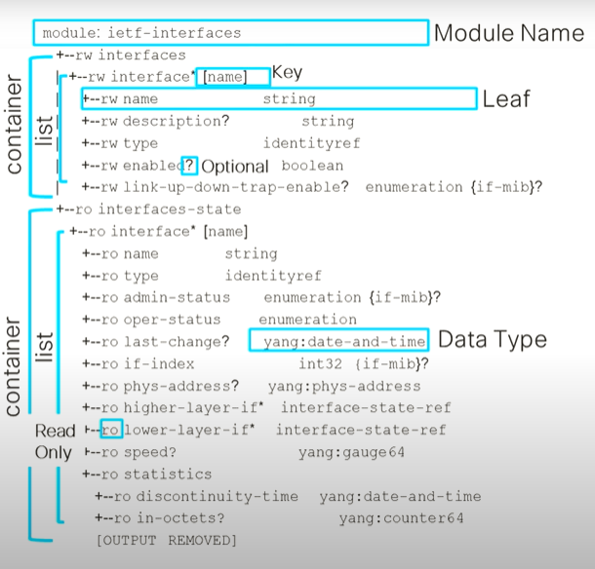
YANG Data Model => RESTCONF JSON Example
{
"ietf-interfaces:interfaces": {
"interface": [{
"name": "GigabitEthernet1",
"description": "VBox",
"type": "iana-if-type:ethernetCsmacd",
"enabled": true,
"ietf-ip:ipv4": {
"address": [{
"ip": "192.168.56.101",
"netmask": "255.255.255.0"
}]
},
"ietf-ip:ipv6": {}
},
{
"name": "Loopback9",
"description": "Lo9",
"type": "iana-if-type:softwareLoopback",
"enabled": true,
"ietf-ip:ipv4": {
"address": [{
"ip": "10.9.9.9",
"netmask": "255.255.255.0"
}]
},
"ietf-ip:ipv6": {}
}
]
}
}
Notes:
RESTCONF
interfaces: container
interface: list => list of interface (container)
GigabitEthernet1: value
Address: list => list of addresses (container)
ip: leaf

Slide 21
RESTCONF Response Data from CSR1000v
RESTCONF URL Example URL: https://192.168.56.101/restconf/data/ietf-interfaces:interfaces Authentication header needed
Raw Response (serialized, machine readable)
{"ietf-interfaces:interfaces": {"interface": [{"name": "GigabitEthernet1", "description": "VBox", "type": "iana-if-type:ethernetCsmacd", "enabled": true, "ietf-ip:ipv4": {"address": [{"ip": "192.168.56.101", "netmask": "255.255.255.0"}]}, "ietf-ip:ipv6": {}}, {"name": "Loopback9", "description": "999", "type": "iana-if-type:softwareLoopback", "enabled": true, "ietf-ip:ipv4": {"address": [{"ip": "10.9.9.9", "netmask": "255.255.255.0"},{"ip": "172.29.0.9", "netmask": "255.255.255.0"}]}, "ietf-ip:ipv6": {}}]}}
Notes:
True (Python) versus true (JSON) In Python, the two Boolean values are True and False (the capitalization must be exactly as shown), and the Python type is bool.
---
RESTCONF is an open standard transport protocol developed within IETF. RFC 8040 describes an HTTP-based protocol that provides a programmatic interface for accessing data defined in YANG. In this part we will practice JSON response data structures that are available within RESTCONF.

Slide 22
RESTCONF Pretty Response with json.dumps
{
"ietf-interfaces:interfaces": {
"interface": [{
"name": "GigabitEthernet1",
"description": "VBox",
"type": "iana-if-type:ethernetCsmacd",
"enabled": true,
"ietf-ip:ipv4": {
"address": [{
"ip": "192.168.56.101",
"netmask": "255.255.255.0"
}]
},
"ietf-ip:ipv6": {}
},
{
"name": "Loopback9",
"description": "Lo9",
"type": "iana-if-type:softwareLoopback",
"enabled": true,
"ietf-ip:ipv4": {
"address": [{"ip": "10.9.9.9", "netmask": "255.255.255.0"},
{"ip": "172.29.0.9", "netmask": "255.255.255.0"}
]
},
"ietf-ip:ipv6": {}
}
]
}
}
Notes:
Pretty: showing hierarchy & tree structure Remark: two ip adresses for loopback interface
Python Code https://drive.google.com/file/d/1QHcVElVI7FBBxlG9VmaWxA7L3q1lngjc/view?usp=sharing
URL to be used (=> to do: add basic authentication) https://192.168.56.101/restconf/data/ietf-interfaces:interfaces IP address to be adapted to the address of your own router, also: add necessary auth header

Slide 23
RESTCONF Filter Response Data
PYTHON CODE TO FILTER JSON DATA FROM CSR1000v (no loop, only indexes used)
print("=> Printing filtered response (first interface)")
print("Interface Name: ")
print(response_json["ietf-interfaces:interfaces"]["interface"][0]["name"])
print("IP Address + Subnet: " )
ip_subnet = resp["ietf-interfaces:interfaces"]["interface"][0]["ietf-ip:ipv4"]["address"]
print(ip_subnet)
print("=> Printing filtered response (three interfaces)")
ip1 = resp["ietf-interfaces:interfaces"]["interface"][0]["ietf-ip:ipv4"]["address"][0]["ip"]
ip2 = resp["ietf-interfaces:interfaces"]["interface"][1]["ietf-ip:ipv4"]["address"][0]["ip"]
ip3 = resp["ietf-interfaces:interfaces"]["interface"][1]["ietf-ip:ipv4"]["address"][1]["ip"]
OUTPUT
=> Printing filtered response (first interface)
Interface Name:
GigabitEthernet1
IP Address + Subnet:
[{'ip': '192.168.56.101', 'netmask': '255.255.255.0'}]
=> Printing filtered response (three interfaces)
192.168.56.101, 10.9.9.9, 172.29.0.9
Notes:
[0] => first item in a list
[1] => second item in a list

Slide 24
Cisco DNA Center API Token
PYTHON API REQUEST import requests import json
### View the Python example to examine the API call URL and authentication parameters
url = "https://sandboxdnac.cisco.com/dna/system/api/v1/auth/token"
resp = requests.post( url, auth=auth, verify=False )
RAW RESPONSE
{"Token":"eyJ0eXAiOiJKV1QiLCJhbGciOiJSUzI1NiJ9.eyJzdWIiOiI1ZTlkYmI3NzdjZDQ3ZTAwNGM2N2RkMGUiLCJhdXRoU291cmNlIjoiaW50ZXJuYWwiLCJ0ZW5hbnROYW1lIjoiVE5UMCI6IxT1u9Vr9I_pj8EmkC3zIUSx5Hjr__TA-8VG86IGwW5-eTRRYaAcf2g8t6UkMs8Y9aGbfcDRgWfxmJOtPxx4_20J7tQIIgzQ9Iod9xY4UYCg8g6qu1DQuEoikWFLW_lH6aA"}
PYTHON FILTER to isolate token
token = resp["Token"]
print(token) eyJ0eXAiOiJKV1QiLCJhbGciOiJSUzI1NiJ9.eyJzdWIiOiI1ZTlkYmI3NzdjZDQ3ZTAwNGM2N2RkMGUiLCJhdXRoU291cmNlIjoiaW50ZXJuYWwiLCJ0ZW5hbnROYW1lIjoiVE5UMCI6IxT1u9Vr9I_pj8EmkC3zIUSx5Hjr__TA-8VG86IGwW5-eTRRYaAcf2g8t6UkMs8Y9aGbfcDRgWfxmJOtPxx4_20J7tQIIgzQ9Iod9xY4UYCg8g6qu1DQuEoikWFLW_lH6aA
Notes:
DNA-Center is an automation and assurance platform for enterprise networks developed by Cisco. The examples in this document are based on the video course by Hank Preston available on DevNet. The video course is part of the Network Controllers module of Programming Basics available on the DevNet website.
In order to get access to DNA Center API’s you have to request a token (and create an environment variable for the token).
Example Code: DNA Center 1 Northbound API Hello Network Simple URL: https://drive.google.com/file/d/1N7izcl2OqXkmiH848fsD7Mxb_EyKrBwW/view?usp=sharing

Slide 25
DNA Center Response Data - Network Device List
Url: https://sandboxdnac.cisco.com:443/dna/intent/api/v1/network-device Authentication header needed
JSON Response (partial)
{
"response": [{
"family": "Switches and Hubs",
"hostname": "cat_9k_1",
"macAddress": "f8:7b:20:67:62:80",
"serialNumber": "FCW2136L0AK",
"upTime": "25 days, 19:42:18.12",
"softwareType": "IOS-XE",
"softwareVersion": "17.3.1",
"bootDateTime": "2020-12-24 17:11:54",
"managementIpAddress": "10.10.22.66",
"platvormId": "C9300-24UX",
"reachabilityStatus": "Reachable",
"series": "Cisco Catalyst 9300 Series Switches",
"type": "Cisco Catalyst 9300 Switch",
"role": "ACCESS",
"instanceUuid": "21335daf-f5a1-4e97-970f-ce4eaec339f6",
"id": "21335daf-f5a1-4e97-970f-ce4eaec339f6"
}],
"version": "1.0"
}
Notes:
The response of the DNA Center Network Device API call returns a complete inventory with a lot of details about networking devices that make up the network. Typically, the JSON response data is very long for human consumption. Filtering and selecting is necessary.

Slide 26
DNA Center Response Data - Network Device List
dev_list = [] #create empty list
# looping through results and filter needed information
# creating new JSON structure
for device in resp_devices_json['response']:
if device['type'] != None:
Dev_dict = {} #create empty dict
dev_dict['hostname'] = device['hostname']
dev_dict['type'] = device['type']
dev_dict['macAddress'] = device['macAddress']
dev_dict['managementIpAddress'] = device['managementIpAddress']
dev_dict['serialNumber'] = device['serialNumber']
dev_dict['softwareType'] = device['softwareType']
dev_dict['softwareVersion'] = device['softwareVersion']
dev_dict['reachabilityStatus'] = device['reachabilityStatus']
dev_list.append(dev_dict)
Notes:
Managing Response Data
Managing response data involves selecting, filtering and looping through the result. Often it is useful to create a simpler data structure.

Slide 27
DNA Center Response Data - Client Health
DNA CENTER REQUEST
import requests
import json
# f-string is used for string formatting of request url
get_resp = requests.get(f"https://{host}/dna/intent/api/v1/client-health",
headers=headers, params=params)
RAW RESPONSE DATA FRAGMENT
{'response': [{'siteId': 'global', 'scoreDetail': [{'scoreCategory': {'scoreCategory': 'CLIENT_TYPE', 'value': 'ALL'}, 'scoreValue': 29, 'clientCount': 82, 'clientUniqueCount': 82, 'starttime': 1611071700000, 'endtime': 1611072000000}, {'scoreCategory': {'scoreCategory': 'CLIENT_TYPE', 'value': 'WIRED'}, 'scoreValue': 100, 'clientCount': 2, 'clientUniqueCount': 2, 'starttime': 1611071700000, 'endtime': 1611072000000, 'scoreList': [{'scoreCategory': {'scoreCategory': 'SCORE_TYPE', 'value': 'POOR'}, 'scoreValue': -1, 'clientCount': 0, 'clientUniqueCount': 0, 'starttime': 1611071700000, 'endtime': 1611072000000}, ...
Notes:
You can use DNA Center Assurance to monitor and troubleshoot the overall health of your enterprise network. An enterprise network consists of network devices and clients. End devices (computer, phone, and so on) are examples of clients. In a network cliensts connect to a network device (access point or switch). Cisco DNA Center supports both wired and wireless clients.
The client health API (client-health) allows to monitor the state of devices in the network. Typically, the JSON response data is very long for human consumption. Filtering and selecting is a very common task.
Example Code: DNA Center Intent API Request Client Health
URL: https://drive.google.com/file/d/1_FW7-r2H8j7W5PPCAMAxzheYDufy6AhG/view?usp=sharing

Slide 28
DNA Center Filtering Response Data - Client Health
FILTERING DATA IN THE RESPONSE
print("----------1----------")
print(type(get_resp_json))
print("----------2----------")
print("Number of clients in first group")
print(get_resp_json["response"][0]["scoreDetail"][0]["clientCount"])
OUTPUT
----------1----------
<class 'dict'>
----------2----------
Number of clients in first group
82
Notes:
If the data has the format of a list, it is necessary to write a loop, or use an index (square brackets [])
["response"][0] will return the first element in the response

Slide 29
Webex Response Data /people/me
Webex API Call: https://api.ciscospark.com/v1/people/me
{"id":"Y2lzY29zcGFya...NlYzQ5NjI5MGY","emails":["Yvan.rooseleer@biasc.be"],"sipAddresses":[{"type":"personal-room","value":"838744612@biasc.webex.com","primary":false},{"type":"personal-room","value":"yvan.rooseleer@biasc.webex.com","primary":false},{"type":"cloud-calling","value":"Yvan.rooseleer@biasc.calls.webex.com","primary":true}],"displayName":"Yvan_Rooseleer","nickName":"Yvan","firstName":"Yvan","lastName":"Rooseleer","avatar":"https://avatar-prod-us-east-2.webexcontent.com/Avtr~V1~e4d4112d-2548-4a47-810e-04fe64-a79b-49c5-823a-92cec494bb9c1d1de6~1600","orgId":"Y2lzY29zcGFyazovL3VzL09SR0FOSctODEwZS0wNGZlNDVlYTE4MWY","roles":["Y2lzY29zcGFya9hZG1pbg"],"licenses":["Y2lTQtNDExMS1hYThkLTA1MDI3N2Y3ZjdlOQ","Y2lzY29zcGFyazovL3VzL0xJQ0VOy53ZWJleC5jb20","Y2lzY29zcGFyazovL3VzL0xJQ0VOUxYmJlNTU2LWQwZmItNGFiNy1hMTYyLTlmNjQ2OGIyYmU5ZA","Y2lzYVOU0UvZTRkNDExMmQtMjU0OC00MWBiNDI4MmQ5NmY5NA","Y2lzYTJhNTNfYmlhc2Mud2ViZXguY29t","Y2lzYZWExODFmOkZTU18xYjcyOGZmOS03ZGU4LTRjYjctOTU0MC0yOTMyMGI1YTQyY2I","Y2lzY29zUtMDRmZTQ1ZWExODFmOkZUTV9mNWZkZTM1Zi00NzA0LTQ2MGEtODEwZi00YzVkMzUyNDFlNjk","Y2lzY29zcExODFmOkNHXzVkYjcwNjYyLWNmYTItNGFjZC04MTRlLTgwYjNiNWVkZjNlZA","Y2lzY29zcGFyazovL3jQ3MzgyOC1hOTgwLTQ3MmYtODE5ZC02YjljY2UwOGU5MmI","Y2lzY29zcGFyazovLmOkZNU185ZWNhNzgxNC0zMzEzLTQ2NGYtOTY0Mi0wMjM5ODc1YmM5Zjg","Y2lzY29zcGFyazovLNDExMmQtMjU0OGE3NS1hNDNmLTBkYmJhMjIyNzg3Zl9iaWFzYy53ZWJleC5jb20","Y2lMwMjFkLTgwYjctNDFiYi1iZThhLWM0YjFiZjcyNTE4YV9iaWFzYy53ZWJleC5jb20","Y2lzY29zcGFyazovL3V0YTQ3LTgxMGUtMDRmZTQ1ZWExODFmOk1kYmFiMDcxYmY0NA","Y2lzY29zcGFyazovL3VzL0xJQ0VOUXzNkMDU3N2RiLTFjOGItNDQ4My1hMTBjLzYy53ZWJleC5jb20"],"created":"2016-12-23T08:38:22.877Z","lastModified":"2021-01-26T17:55:07.662Z","lastActivity":"2021-01-26T17:54:24.481Z","status":"active","invitePending":false,"loginEnabled":true,"type":"person","trainSiteNames":["biasc.webex.com"]}
Notes:
API Call: https://api.ciscospark.com/v1/people/me
Response data changed and incomplete
The example below shows that the Webex API generates a lot of JSON output.

Slide 30
Webex Filtering Response Data
Display Filtered Results From Webex
print("Displaying partial information")
print("Name: " + resp['displayName'])
print("Created: " + resp['created'])
print("User Type: " + resp['type'])
print("User Status: " + resp['status'])
Output
Displaying partial information
Name: Yvan Rooseleer
Created: 2016-12-23T08:38:22.877Z
User Type: person
User Status: active

Slide 31
Ansible Response Data
Ansible command to gather facts from the webservers inventory $ ansible webservers -m gather_facts --tree ./tmp_facts URL for the complete response file: https://docs.google.com/document/d/1Z7wO5r8XaBirxXo06CmC8a6r5cCMezQQqUOcHxXhCyk/edit?usp=sharing Partial Output (with some response data highlighted) {"ansible_facts": {"ansible_all_ipv4_addresses": ["192.0.2.1", "192.0.2.2", "192.0.2.3", "192.0.2.4", "192.0.2.5", "10.0.2.15", "172.17.0.1"], "ansible_all_ipv6_addresses": ["fe80::9002:c8ff:fee8:bb09", "fe80::3c67:a5ff:fe17:e4cf", "fe80::a00:27ff:fee9:3de6", "fe80::42:3ff:fef6:9477"], "ansible_apparmor": {"status": "enabled"}, "ansible_architecture": "x86_64", "ansible_bios_date": "12/01/2006", "ansible_bios_version": "VirtualBox", "ansible_cmdline": {"BOOT_IMAGE": "/boot/vmlinuz-5.4.0-37-generic", "quiet": true, "ro": true, "root": "UUID=fb261367-cf98-4bce-b682-42b3de0a8ab9", "vga": "792", "zswap.enabled": "1"}, "ansible_date_time": {"date": "2021-01-20", "day": "20", "epoch": "1611160850", "hour": "16", "iso8601": "2021-01-20T16:40:50Z", "iso8601_basic": "20210120T164050181658", "iso8601_basic_short": "20210120T164050", "iso8601_micro": "2021-01-20T16:40:50.181774Z", "minute": "40", "month": "01", "second": "50", "time": "16:40:50", "tz": "UTC", "tz_offset": "+0000", "weekday": "Wednesday", "weekday_number": "3", "weeknumber": "03", "year": "2021"}, "ansible_default_ipv4": {"address": "10.0.2.15", "alias": "enp0s3", "broadcast": "10.0.2.255", "gateway": "10.0.2.2", "interface": "enp0s3", "macaddress": "08:00:27:e9:3d:e6", "mtu": 1500, "netmask": "255.255.255.0", "network": "10.0.2.0", "type": "ether"}, "ansible_default_ipv6": {}, … , "ansible_distribution": "Ubuntu", "ansible_distribution_file_parsed": true, "ansible_distribution_file_path": "/etc/os-release", "ansible_distribution_file_variety": "Debian", "ansible_distribution_major_version": "20", "ansible_distribution_release": "focal", "ansible_distribution_version": "20.04", "ansible_dns": {"nameservers": ["127.0.0.53"], … , "ansible_nodename": "labvm", "ansible_os_family": "Debian", "ansible_pkg_mgr": "apt", "ansible_proc_cmdline": {"BOOT_IMAGE": "/boot/vmlinuz-5.4.0-37-generic", "quiet": true, "ro": true, "root": "UUID=fb261367-cf98-4bce-b682-42b3de0a8ab9", "vga": "792", "zswap.enabled": "1"}, "ansible_processor": ["0", "GenuineIntel", "Intel(R) Core(TM) i7-7600U CPU @ 2.80GHz", "1", "GenuineIntel", "Intel(R) Core(TM) i7-7600U CPU @ 2.80GHz"], "ansible_processor_cores": 2, "ansible_processor_count": 1, "ansible_processor_threads_per_core": 1, "ansible_processor_vcpus": 2, "ansible_product_name": "VirtualBox", "ansible_product_serial": "NA", "ansible_product_uuid": "NA", "ansible_product_version": "1.2", "ansible_python": {"executable": "/usr/bin/python3", "has_sslcontext": true, "type": "cpython", "version": {"major": 3, "micro": 2, "minor": 8, "releaselevel": "final", "serial": 0}, "version_info": [3, 8, 2, "final", 0]}, "ansible_python_version": "3.8.2", "ansible_real_group_id": 900, "ansible_real_user_id": 900, "ansible_selinux": {"status": "disabled"}, "ansible_selinux_python_present": true, "ansible_service_mgr": "systemd", … , "ipv6": [{"address": "fe80::3c67:a5ff:fe17:e4cf", "prefix": "64", "scope": "link"}], "macaddress": "3e:67:a5:17:e4:cf", "mtu": 1500, "promisc": true, "speed": 10000, "timestamping": ["tx_software", "rx_software", "software"], "type": "ether"}, "ansible_virtualization_role": "guest", "ansible_virtualization_type": "virtualbox", "discovered_interpreter_python": "/usr/bin/python3", "gather_subset": ["all"], "module_setup": true}, "changed": false, "deprecations": [], "warnings": []}
Notes:
Response from Ansible (very long json file, needs filtering)
URL for the complete file: https://docs.google.com/document/d/1Z7wO5r8XaBirxXo06CmC8a6r5cCMezQQqUOcHxXhCyk/edit?usp=sharing

Slide 32
Ansible Response Data
Parsing And Filtering Ansible Json Data -- Keys Level 1
Code
ansible_dict = json.loads(ansible_json_doc)
print(ansible_dict.keys())
Output Level 1
dict_keys(['ansible_facts', 'changed', 'deprecations', 'warnings'])

Slide 33
Ansible Response Data
Parsing And Filtering Ansible Json Data -- Keys Level 2
Code
print(ansible_dict['ansible_facts'].keys())
Output Level 2
['ansible_all_ipv4_addresses', 'ansible_all_ipv6_addresses', 'ansible_default_ipv4', 'ansible_default_ipv6''ansible_distribution', 'ansible_distribution_file_variety', 'ansible_distribution_major_version', 'ansible_distribution_release', 'ansible_distribution_version', 'ansible_env', 'ansible_kernel', 'ansible_kernel_version', 'ansible_python_version']

Slide 34
Ansible Response Data
Parsing And Filtering Ansible JSON Data -- Keys Level 2
Code
print("Ansible Distribution: " + \ ansible_dict["ansible_facts"]["ansible_distribution"])
print("Ansible Distribution Release: " + \ ansible_dict["ansible_facts"]["ansible_distribution_release"])
print("Ansible Distribution Version: " \ +ansible_dict["ansible_facts"]["ansible_distribution_version"])
Output Level 2
Ansible Distribution: Ubuntu
Ansible Distribution Release: focal
Ansible Distribution Version: 20.04

Slide 35
Ansible Response Data
Parsing And Filtering Ansible JSON Data -- Keys Level 2 and 3
Code
print("Ansible Kernel: " + ansible_dict["ansible_facts"]["ansible_kernel"])
print("Ansible Home: " + \ ansible_dict["ansible_facts"]["ansible_env"]["HOME"])
print("Ansible User: " + \ ansible_dict["ansible_facts"]["ansible_env"]["USER"])
print("IP Address: " + \ ansible_dict["ansible_facts"]["ansible_default_ipv4"]["address"])
Output Level 2-3
Ansible Kernel: 5.4.0-37-generic Ansible Home: /home/devasc
Ansible User: devasc
IP Address: 10.0.2.15
Notes:
Like most examples this example is based on the DevNet Associate Course

Slide 36
Docker Response Data -- docker image (partial)
$ docker image inspect ubuntu
Output (with some response data highlighted) [{"Id": "sha256:9140108b62dc87d9b278bb0d4fd6a3e44c2959646eb966b86531306faa81b09b", "RepoTags": ["ubuntu:latest"], "RepoDigests": ["ubuntu@sha256:bc2f7250f69267c9c6b66d7b6a81a54d3878bb85f1ebb5f951c896d13e6ba537"], "Parent": "", "Comment": "", "Created": "2020-09-25T22:34:30.295807036Z", "Container": "1046a5d685aef5c37d1829040ca8083b94e4c069ca4963f4b16a6ade2e077b06", "ContainerConfig": {"Hostname": "1046a5d685ae", "Domainname": "", "User": "", "AttachStdin": false, "AttachStdout": false, "AttachStderr": false, "Tty": false, "OpenStdin": false, "StdinOnce": false, "Env": ["PATH=/usr/local/sbin:/usr/local/bin:/usr/sbin:/usr/bin:/sbin:/bin"], "Cmd": ["/bin/sh", "-c", "#(nop) ", "CMD [\"/bin/bash\"]"], "ArgsEscaped": true, "Image": "sha256:4ff2090064e7e38688bce713d50f3202d227b3c89fecea1434271c912ccd47e0", "Volumes": null, "WorkingDir": "", "Entrypoint": null, "OnBuild": null, "Labels": {}}, "DockerVersion": "18.09.7", "Author": "", "Config": {"Hostname": "", "Domainname": "", "User": "", "AttachStdin": false, "AttachStdout": false, "AttachStderr": false, "Tty": false, "OpenStdin": false, "StdinOnce": false, "Env": ["PATH=/usr/local/sbin:/usr/local/bin:/usr/sbin:/usr/bin:/sbin:/bin"], "Cmd": ["/bin/bash"], "ArgsEscaped": true, "Image": "sha256:4ff2090064e7e38688bce713d50f3202d227b3c89fecea1434271c912ccd47e0", "Volumes": null, "WorkingDir": "", "Entrypoint": null, "OnBuild": null, "Labels": null}, "Architecture": "amd64", "Os": "linux", "Size": 72875723, "VirtualSize": 72875723, "GraphDriver": {"Data": {"LowerDir": "/var/lib/docker/overlay2/5d66f43ef0d92430a195045c4715ff3d49ee88ccb0bb7f6e69ccc5d60fde0ece/diff:/var/lib/docker/overlay2/0b75d53292ccb20230879e49c7fe6eea157addb083d414ba3d0485959cd35086/diff", "MergedDir": "/var/lib/docker/overlay2/c3bab8487f590bfd66e53db0b1902ab5a8b8fbfa1f02cfc3b4f0f9fa25158f2d/merged", "UpperDir": "/var/lib/docker/overlay2/c3bab8487f590bfd66e53db0b1902ab5a8b8fbfa1f02cfc3b4f0f9fa25158f2d/diff", "WorkDir": "/var/lib/docker/overlay2/c3bab8487f590bfd66e53db0b1902ab5a8b8fbfa1f02cfc3b4f0f9fa25158f2d/work"}, "Name": "overlay2"}, "RootFS": {"Type": "layers", "Layers": ["sha256:d42a4fdf4b2ae8662ff2ca1b695eae571c652a62973c1beb81a296a4f4263d92", "sha256:90ac32a0d9ab11e7745283f3051e990054616d631812ac63e324c1a36d2677f5", "sha256:782f5f011ddaf2a0bfd38cc2ccabd634095d6e35c8034302d788423f486bb177"]}, "Metadata": {"LastTagTime": "0001-01-01T00:00:00Z"}}]
Notes:
Output from the following Docker command $ docker image inspect ubuntu
--
Definitely, this is information that needs to be processed
---
Here is the complete docker response

Slide 37
Docker Response Data
Code Example
import json
### Converting json string to dict
docker_dict = json.loads(docker_json_file)
### Filtering Response Data from dict
print(docker_dict[0]["Created"])
print(docker_dict[0]["Architecture"])
print(docker_dict[0]["Os"])
Output
### Created
2020-09-25T22:34:30.295807036Z
### Architecture
Amd64
### OS
linux
Notes:
import json
print("---------1--------")
print("Converting json string to dict, and showing keys at level 1")
docker_dict = json.loads(docker_json_file)
print(docker_dict[0].keys())
print("---------2--------")
print("Converting dict to raw json")
docker_json = json.dumps(docker_dict)
print("---------3--------")
print("Filtering from dict")
print(docker_dict[0]["Created"])
print(docker_dict[0]["Architecture"])
print(docker_dict[0]["Os"])
---
---------1--------
Converting json string to dict, and showing keys at level 1
dict_keys(['Id', 'RepoTags', 'RepoDigests', 'Parent', 'Comment', 'Created', 'Container', 'ContainerConfig', 'DockerVersion', 'Author', 'Config', 'Architecture', 'Os', 'Size', 'VirtualSize', 'GraphDriver', 'RootFS', 'Metadata'])
---------2--------
Converting dict to raw json
---------3--------
Filtering from dict
2020-09-25T22:34:30.295807036Z
amd64
linux

Slide 38
Docker Response Data -- docker network (partial)
$ docker network inspect \ bridge
Notes:
Output from the following Docker command $ docker network inspect bridge
--
Definitely, this is information that needs to be processed
---
Here is the complete docker response

Slide 39
Python Script - Filtering Response Data from Docker
Code Example
import json
### Converting json string to dict, and showing keys at level 1
docker_net_dict = json.loads(docker_json_file2)
### Filtering from dict
print(docker_net_dict[0]["Name"])
print(docker_net_dict[0]["Created"])
print(docker_net_dict[0]["Containers"]["4e9a64e...bd52b811"]["IPv4Address"])
Output bridge
2020-12-09T17:51:15.816558163Z
172.17.0.3/16

Slide 40
Exercise - Webex Groups Dict Example
groups_struc = {
"groups": [
{ "group": { "group_id": "G-A"
, "group_name": "DEVASC_A" ,
"members": [
{"person_id": "P-1" , "person_name": "Noel", "email": "noel@odisee.be"},
{"person_id": "P-2" , "person_name": "Mary", "email": "mary@odisee.be"},
{"person_id": "P-3" , "person_name": "Jens", "email": "jens@odisee.be"}
]
}
},
{ "group": { "group_id": "G-B"
, "group_name": "DEVASC_B" ,
"members": [
{"person_id": "P-4" ,"person_name": "Ives", "email": "ives@odisee.be"},
{"person_id": "P-5" ,"person_name": "John", "email": "john@odisee.be"},
{"person_id": "P-6" ,"person_name": "Alec", "email": "alec@odisee.be"}
]
}
}
]
}
Notes:
Exercises
Write a Python script to make a list of all names and email addresses
Write a Python script to select the name of the first person in DEVASC_A
Write a Python script to make a list of all names and email addresses of DEVASC_B

Slide 41
Exercise - Webex Groups Python Script
Code Example ### First group with first member, second group with first member
### Select first group, first person
resp_a1 = groups_struc["groups"][0]["group"]["group_name"]
resp_a2 = groups_struc["groups"][0]["group"]["members"][0]["person_name"]
### Select second group, only the first person
resp_b1 = groups_struc["groups"][1]["group"]["group_name"]
resp_b2 = groups_struc["groups"][1]["group"]["members"][0]["person_name"]
Output
First group, First person
DEVASC_A => Noel
Second group, First person
DEVASC_B => Ives
And so on … (more groups, more members)

Slide 42
Exercise - Webex Groups Python Script
Code Example ### All groups with members and email addresses
for g in groups_struc["groups"]:
print(g["group"]["group_name"])
for p in g["group"]["members"]:
print(p["person_name"] + " => " + p["email"])
Output
DEVASC_A
Noel => noel@odisee.be
Mary => mary@odisee.be
Jens => jens@odisee.be
DEVASC_B
Ives => ives@odisee.be
John => john@odisee.be
Alec => alec@odisee.be
And so on … (more groups)

Slide 43
Loop Exercise 2 - Network Devices Dict Example
rack_struc = {
"rack": [
{ "device": { "dev_id": "D1" ,
"dev_name": "R1" ,
"role": "router" ,
"interfaces": [
{"interface": "GigabitEthernet1" ,
"ipaddress": "10.0.1.1",
"subnet_mask": "255.255.255.0"},
{"interface": "GigabitEthernet2" ,
"ipaddress": "10.0.3.1",
"subnet_mask": "255.255.255.0"},
{"interface": "GigabitEthernet3" ,
"ipaddress": "10.0.4.1",
"subnet_mask": "255.255.255.0"}
]
}
}
]
}
And so on … (if more network devices)
Notes:
Exercises
Write a Python script to display all network devices, interfaces and IP addresses
Write a Python script to select the name of the first device
Write a Python script to display all interfaces and IP addresses of device R1
---
rack_struc = {
"rack": [
{ "device": { "dev_id": "D1" ,
"dev_name": "R1" ,
"role": "router" ,
"interfaces": [
{"interface": "GigabitEhternet1" ,
"ipaddress": "10.0.1.1",
"subnet_mask": "255.255.255.0"},
{"interface": "GigabitEhternet2" ,
"ipaddress": "10.0.3.1",
"subnet_mask": "255.255.255.0"},
{"interface": "GigabitEhternet3" ,
"ipaddress": "10.0.4.1",
"subnet_mask": "255.255.255.0"}
]
}
},
{ "device": { "dev_id": "D2" , "dev_name": "C1" , "role": "core" ,
"interfaces": [
{"interface": "VLAN1" ,
"ipaddress": "10.0.1.2" ,
"subnet_mask": "255.255.255.0"},
{"interface": "VLAN2" ,
"ipaddress": "10.0.2.1" ,
"subnet_mask": "255.255.255.0"},
{"interface": "VLAN20" ,
"ipaddress": "10.0.20.1",
"subnet_mask": "255.255.255.0"}
]
}
},
{ "device": { "dev_id": "D3" , "dev_name": "AC" , "role": "access" ,
"interfaces": [
{"interface": "VLAN2" ,
"ipaddress": "10.0.2.2",
"subnet_mask": "255.255.255.0"}
]
}
}
]
}

Slide 44
Loop Exercise 2 - Network Devices Python Script
Code Sample ### All network devices interfaces and ip addresses
for g in rack_struc["rack"]:
print(g["device"]["dev_name"])
for p in g["device"]["interfaces"]:
print(p["interface"]+" => "+p["ipaddress"])
Output
R1
GigabitEthernet1 => 10.0.1.1
GigabitEthernet2 => 10.0.3.1
GigabitEthernet3 => 10.0.4.1
C1
VLAN1 => 10.0.1.2
VLAN2 => 10.0.2.1
VLAN20 => 10.0.20.1
AC
VLAN2 => 10.0.2.2
And so on … (if more network devices)

Slide 45
Part 2
Part 1: DevNet Associate: Filtering JSON Data
Description: This part covers some aspects of the DevNet Associate course. Join to learn how to interpret JSON data coming from Webex Teams API, DNAC API, Docker inspect, Ansible.
Part 2: DevNet Associate: Generating JSON Data
Description: This part covers some aspects of the DevNet Associate course. Join to learn how to generate JSON data for Webex Teams API, IP Devices and Network Services from a source in the Excel format.
Notes:
Cisco Networking Academy Courses
DevNet Associate 1.0
Emerging Technology Workshop: Experimenting with REST APIs using Webex Teams
Emerging Technology Workshop: Model-Driven Programmability
Emerging Technology Workshop: Network Programmability with Cisco APIC-EM, no longer supported

Slide 46
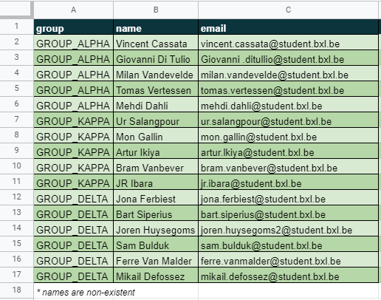
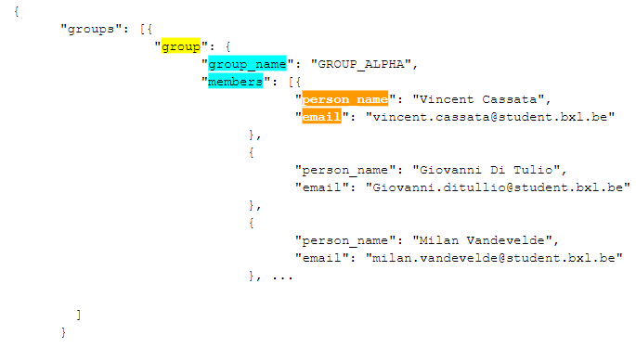
Problem Statement
Create Webex Spaces and Members from Source Data in Excel Format
Transform 2-dimensional structure into hierarchical tree structure
Simpler than YANG Model: less hierarchical levels
Notes:
Remarks
If there is no hierarchy, some data have to be repeated (as shown in the spreadsheet

Slide 47
Task 1 - Source Spreadsheet Webex Groups
Business Context At a recent meeting it was decided that a number of new Webex groups should be created, each with several members.
The spreadsheet on the left was created by communication and sent to Webex admin.
The decision was made that JSON should be used as an intermediate format to automate the creation of new groups and memberships.
Notes:
Here is an example of a source spreadsheet webex_groups.xlsx with three columns (group, name, email)
The goal is to read the excel data and generate a json tree structure: two levels
The target structure you can find on the next slide.
Result Example in Python dict format:
{'group': 'GROUP_ALPHA', 'person_name': 'Vincent Cassata', 'email': 'vincent.cassata@student.bxl.be'} {'group': 'GROUP_ALPHA', 'person_name': 'Giovanni Di Tulio', 'email': 'Giovanni.ditullio@student.bxl.be'}

Slide 48
Task 1 - Target Structure Webex Groups
groups_struc = {
"groups": [
{ "group": { "group_id": "G-A"
, "group_name": "DEVASC_A" ,
"members": [
{"person_id": "P-1" , "person_name": "Noel", "email": "noel@odisee.be"},
{"person_id": "P-2" , "person_name": "Mary", "email": "mary@odisee.be"},
{"person_id": "P-3" , "person_name": "Jens", "email": "jens@odisee.be"}
]
}
},
{ "group": { "group_id": "G-B"
, "group_name": "DEVASC_B" ,
"members": [
{"person_id": "P-4" ,"person_name": "Ives", "email": "ives@odisee.be"},
{"person_id": "P-5" ,"person_name": "John", "email": "john@odisee.be"},
{"person_id": "P-6" ,"person_name": "Alec", "email": "alec@odisee.be"}
]
}
}
]
}
Notes:
Hierarchical levels are important in JSON in order not to have to repeat the name of the group for all the members.
Without a target data structure it is impossible to create the script
This structure contains test data.
The target structure on this slide has been verified with JSONLint - The JSON Validator

Slide 49
Task 1 - Step 1: Define Python Data Rules
### REWRITING RULES TO GENERATE THE DATA STRUCTURE
Most of the time you will have to manage structures of type dict and list. These are very common for JSON data exchange.
member_dict => {"person_name": "x", "email": "y", "group":"z"}
member_list => [member_dict]
group_dict => {group_name, member_list} | {group_name, [member_dict]}
group_list => [group_dict]
groups_struc => {group_list} | {[group_dict]}
Notes:
Without data rules it is not feasible to write a script to manage the data

Slide 50
Task 1 - Step 2: Read Two Excel Records
### Simplified code: converting Excel into initial Python dict import xlrd # library to manage excel spreadsheets import json # library to manage JSON classes and functions wb = xlrd.open_workbook("webex_groups.xlsx") sheet = wb.sheet_by_index(0) # read data from the first tab member_dict["group"] = sheet.cell_value(1, 0) member_dict["person_name"] = sheet.cell_value(1, 1) member_dict["email"] = sheet.cell_value(1, 2) member_dict["group"] = sheet.cell_value(2, 0) member_dict["person_name"] = sheet.cell_value(2, 1) member_dict["email"] = sheet.cell_value(2, 2) print(member_dict) Result Example in Python dict format: {'group': 'GROUP_ALPHA', 'person_name': 'Vincent Cassata', 'email': 'vincent.cassata@student.bxl.be'} {'group': 'GROUP_ALPHA', 'person_name': 'Giovanni Di Tulio', 'email': 'Giovanni.ditullio@student.bxl.be'}

Slide 51
Task 1 - Step 3: Read All Excel Records (loop)
### Simplified code: converting all Excel data into initial Python dict import xlrd # library to manage excel spreadsheets import json # library to manage JSON classes and functions def find_all_persons_and_groups(xlf): wb = xlrd.open_workbook(xlf) sheet = wb.sheet_by_index(0) number_rows = sheet.nrows member_list = [] for r in range(number_rows): if r > 0: ### first row contains column names member_dict["group"] = sheet.cell_value(r, 0) member_dict["person_name"] = sheet.cell_value(r, 1) member_dict["email"] = sheet.cell_value(r, 2) member_list.append(member_dict.copy()) return member_list Function Call in Python Script: member_list = find_all_persons_and_groups("webex_groups.xlsx") Result Example: [{'group': 'GROUP_ALPHA', 'person_name': 'Vincent Cassata', 'email': 'vincent.cassata@student.bxl.be'}, {'group': 'GROUP_ALPHA', 'person_name': 'Giovanni Di Tulio', 'email': 'Giovanni .ditullio@student.bxl.be'}, … ]
Notes:
COMPLETE CODE WITH ADDED VALIDATION STATEMENTS
def find_all_persons_and_groups(n_rows):
member_tab = [] ### member_tab = [member_dict]
for r in range(n_rows):
#print(sheet.cell_value(r, 0))
print(sheet.cell_value(r, 0) + ': ' + sheet.cell_value(r, 1) + ' => ' + sheet.cell_value(r, 2))
if r > 0: ### first row contains columns names
COL_A = sheet.cell_value(r, 0) #### column A
COL_B = sheet.cell_value(r, 1) #### column B
COL_C = sheet.cell_value(r, 2) #### column C
member_dict["group"] = COL_A
member_dict["person_name"] = COL_B
member_dict["email"] = COL_C
print(member_dict)
member_tab.append(member_dict.copy())
return member_tab

Slide 52
Task 1 - Step 4: Create Structure Level 1
### Simplified code: making list of groups from initial Python dict
###
def make_list_of_groups(member_list):
group_list = []
for rec in member_list:
group_list.append(rec["group"])
return group_list # => return the list of groups
###
Function Call in Python Script: group_list = make_list_of_groups(member_list) Result Example: list of groups ['GROUP_ALPHA', 'GROUP_KAPPA', 'GROUP_DELTA']

Slide 53
Task 1 - Step 5: Create Structure Level 1 & 2
### Simplified code: attaching group members (L2) to their group (L1)
def attach_members_to_groups(group_rec, member_list):
mem_dict = {}
mem_list = [mem_dict]
for membr in member_list:
if membr["group"] == group_rec:
mem_dict["person_name"] = membr["person_name"]
mem_dict["email"] = membr["email"]
mem_list.append(mem_dict.copy())
return mem_list
Function Call in Python Script: for group_rec in group_list: all_members = attach_members_to_groups(group_rec, member_list) Result Example {'group': {'group': {'group_name': 'GROUP_ALPHA', 'members': [{'person_name': 'Vincent Cassata', 'email': 'vincent.cassata@student.bxl.be'}, {'person_name': 'Giovanni Di Tulio', 'email': 'Giovanni.ditullio@student.bxl.be'}, ...

Slide 54
Task 1 - Step 6: Run main() function
### Simplified code: calling three functions + creating final data structure
def main():
member_list = find_all_persons_and_groups("webex_groups.xlsx")
group_list = make_list_of_groups(member_list)
all_members = []
for group_rec in group_list:
all_members = attach_members_to_groups(group_rec, member_list)
group_dict["group"] = { "group": {"group_name": group_rec, "members": all_members }}
groups_struc['groups'].append(group_dict["group"])
js_groups = json.dumps(groups_struc)
Function Call in Python Script: #### execute main() when called directly if __name__ == '__main__': main()
Result Example: next step

Slide 55
Task 1 - Step 7: Verify or Validate Results (RAW)
{"groups": [{"group": {"group_name": "GROUP_ALPHA", "members": [{"person_name": "Vincent Cassata", "email": "vincent.cassata@student.bxl.be"}, {"person_name": "Giovanni Di Tulio", "email": "Giovanni.ditullio@student.bxl.be"}, {"person_name": "Milan Vandevelde", "email": "milan.vandevelde@student.bxl.be"}, {"person_name": "Tomas Vertessen", "email": "tomas.vertessen@student.bxl.be"}, {"person_name": "Mehdi Dahli", "email": "mehdi.dahli@student.bxl.be"}]}}, {"group": {"group_name": "GROUP_KAPPA", "members": [{"person_name": "Ur Salangpour", "email": "ur.salangpour@student.bxl.be"}, {"person_name": "Mon Gallin", "email": "mon.gallin@student.bxl.be"}, {"person_name": "Artur Ikiya", "email": "artur.lkiya@student.bxl.be"}, {"person_name": "Bram Vanbever", "email": "bram.vanbever@student.bxl.be"}, {"person_name": "JR Ibara", "email": "jr.ibara@student.bxl.be"}]}}, {"group": {"group_name": "GROUP_DELTA", "members": [{"person_name": "Jona Ferbiest", "email": "jona.ferbiest@student.bxl.be"}, {"person_name": "Bart Siperius", "email": "bart.siperius@student.bxl.be"}, {"person_name": "Joren Huysegoms", "email": "joren.huysegoms2@student.bxl.be"}, {"person_name": "Sam Bulduk", "email": "sam.bulduk@student.bxl.be"}, {"person_name": "Ferre Van Malder", "email": "ferre.vanmalder@student.bxl.be"}, {"person_name": "Mikail Defossez", "email": "mikail.defossez@student.bxl.be"}]}}]}
Notes:
The generated structure on this slide has been checked manually with the source file.
The generated structure on this slide has been verified with JSONLint - The JSON Validator

Slide 56
Task 1 - Step 7b: Verify or Validate Results (Tree)
{ "groups": [{ "group": { "group_name": "GROUP_ALPHA", "members": [{ "person_name": "Vincent Cassata", "email": "vincent.cassata@student.bxl.be" }, { "person_name": "Giovanni Di Tulio", "email": "Giovanni.ditullio@student.bxl.be" }, { "person_name": "Milan Vandevelde", "email": "milan.vandevelde@student.bxl.be" }, … ] }
Notes:
The structure on this slide has been verified and generated by JSONLint - The JSON Validator
The generated structure on this slide has been checked manually with the source file.
{
"groups": [{
"group": {
"group_name": "GROUP_ALPHA",
"members": [{
"person_name": "Vincent Cassata",
"email": "vincent.cassata@student.bxl.be"
},
{
"person_name": "Giovanni Di Tulio",
"email": "Giovanni .ditullio@student.bxl.be"
},
{
"person_name": "Milan Vandevelde",
"email": "milan.vandevelde@student.bxl.be"
},
{
"person_name": "Tomas Vertessen",
"email": "tomas.vertessen@student.bxl.be"
},
{
"person_name": "Mehdi Dahli",
"email": "mehdi.dahli@student.bxl.be"
}
]
}
},
{
"group": {
"group_name": "GROUP_KAPPA",
"members": [{
"person_name": "Ur Salangpour",
"email": "ur.salangpour@student.bxl.be"
},
{
"person_name": "Mon Gallin",
"email": "mon.gallin@student.bxl.be"
},
{
"person_name": "Artur Ikiya",
"email": "artur.lkiya@student.bxl.be"
},
{
"person_name": "Bram Vanbever",
"email": "bram.vanbever@student.bxl.be"
},
{
"person_name": "JR Ibara",
"email": "jr.ibara@student.bxl.be"
}
]
}
},
{
"group": {
"group_name": "GROUP_DELTA",
"members": [{
"person_name": "Jona Ferbiest",
"email": "jona.ferbiest@student.bxl.be"
},
{
"person_name": "Bart Siperius",
"email": "bart.siperius@student.bxl.be"
},
{
"person_name": "Joren Huysegoms",
"email": "joren.huysegoms2@student.bxl.be"
},
{
"person_name": "Sam Bulduk",
"email": "sam.bulduk@student.bxl.be"
},
{
"person_name": "Ferre Van Malder",
"email": "ferre.vanmalder@student.bxl.be"
},
{
"person_name": "Mikail Defossez",
"email": "mikail.defossez@student.bxl.be"
}
]
}
}
]
}

Slide 57
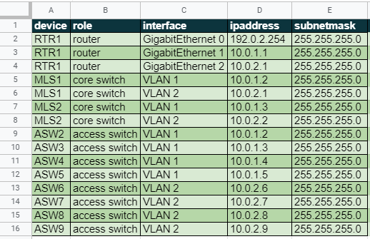
Task 2 - Source Spreadsheet Network Devices
Business Context
This spreadsheet was created by IT staff and sent to the Networking Team.
There are eleven network devices that need to be configured with one or more interfaces and ip addresses.
The task is to transform the spreadsheet into JSON format and to transmit the resulting data to a network automation tool.
The automation tool is able to accept and transform JSON data.
Notes:
The task is to read the Excel data from ipdevices.xlsx.
The goal is to read the excel data and generate a json tree structure.
The target structure you can find on the next slide.

Slide 58
Task 2 - Target Structure Network Devices - 2 levels
{
"rack": [{
"device": {
"dev_name": "RTR1",
"role": "router"
},
"interfaces": [{
"interface": "GigabitEthernet 0",
"ipaddress": "192.0.2.254",
"subnetmask": "255.255.255.0"
},
{
"interface": "GigabitEthernet 1",
"ipaddress": "10.0.1.1",
"subnetmask": "255.255.255.0"
},
{
"interface": "GigabitEthernet 2",
"ipaddress": "10.0.2.1",
"subnetmask": "255.255.255.0"
}
]
}, ...
=> Develop a Python script based on the example explained in task 1.
Notes:
Please develop a solution based on the example shown in task 1.
---
For practical purposes the number of levels will be restricted to two levels. Generating a YANG compliant JSON structure is more difficult because there are more hierarchical levels.
The target structure on this slide has been verified with JSONLint - The JSON Validator
The JSON structure has been validate by JSON Lint.
--- SOLUTION ---
#### FUNCTIONS TO CREATE (A) list of devices and (B) list of device interfaces
### Using an excel file as input for a Python script
### This script creates a JSON structure based on information an excel spreadsheet
### You have to understand Python dict and Python lists
### Contact yvan.rooseleer@biasc.be if you have questions
### It's up to you to ### WRITE YOUR OWN CODE ### where this is indicated
### Validate your JSON structure
### Use print statements to understand return values and return types
### There is a simplified solution (main2) and a more difficult solution (main)
###
import xlrd
import json
###
### RULES
inventory_dict = {} #### {"interface": "gi0/1", "ip_address": "1.2.2.1", "subnet_mask": "255.255.255.0", "device": "dv"
inventory_list = [] #### [inventory_dict]
interface_dict = {} #### {"interface": "gi0/1", "ip_address": "1.2.2.1", "subnet_mask": "255.255.255.0"}
interface_list = [] #### [interface_dict]
dev_dict = {} #### {"device": {dev_name": "n", "role": "r", interfaces": interface_list}}
dev_list = [] #### [dev_dict]
rack_struc = {} #### {dev_dict_list}
rack_struc["rack"] = []
####
def find_all_device_interfaces(xlf):
### READ EXCEL FILE AND RETURN NUMBER OF ROWS
wb = xlrd.open_workbook(xlf)
sheet = wb.sheet_by_index(0)
number_rows = sheet.nrows
dev_interfaces = []
for r in range(number_rows):
if r > 0: ### first row contains columns names
COL_A = sheet.cell_value(r, 0) #### column A
COL_B = sheet.cell_value(r, 1) #### column B
COL_C = sheet.cell_value(r, 2) #### column C
COL_D = sheet.cell_value(r, 3) #### column D
COL_E = sheet.cell_value(r, 4) #### column E
inventory_dict["device"] = COL_A
inventory_dict["role"] = COL_B
inventory_dict["interface"] = COL_C
inventory_dict["ipaddress"] = COL_D
inventory_dict["subnetmask"] = COL_E
dev_interfaces.append(inventory_dict.copy()) # need to use copy()
return dev_interfaces
def make_list_of_devices_and_roles(inventory):
dev_list = []
dev_dict = {}
mem = {}
for rec in inventory:
dev_dict["dev_name"] = rec["device"]
dev_dict["role"] = rec["role"]
if mem != dev_dict["dev_name"]:
dev_list.append(dev_dict.copy()) # need to use copy()
mem = dev_dict["dev_name"]
#for rec in loc_g:
#print(rec)
#del loc_g[0] ### if last item copied as first item
return dev_list
def attach_interfaces_to_devices(dev_name, inventory):
intf_dict = {}
intf_list = [intf_dict]
for item in inventory:
if item["device"] == dev_name:
if item["device"] != None:
intf_dict["interface"] = item["interface"]
intf_dict["ipaddress"] = item["ipaddress"]
intf_dict["subnetmask"] = item["subnetmask"]
intf_list.append(intf_dict.copy()) # need to use copy()
del intf_list[0] ### if last item copied as first item
return intf_list
#### MAIN ####
def main():
inventory_list = find_all_device_interfaces("devices_ip.xlsx")
device_list = make_list_of_devices_and_roles(inventory_list)
for device_rec in device_list:
intf_list = attach_interfaces_to_devices(device_rec["dev_name"], inventory_list)
dev_dict["device"] = { "device": device_rec , "interfaces": intf_list }
rack_struc["rack"].append(dev_dict["device"])
js_rack = json.dumps(rack_struc)
#### execute main() when called directly
if __name__ == '__main__':
main()

Slide 59
Task 2 - Target Structure Network Devices - YANG
{
"ietf-interfaces:interfaces": {
"interface": [{
"name": "GigabitEthernet1",
"description": "VBox",
"type": "iana-if-type:ethernetCsmacd",
"enabled": true,
"ietf-ip:ipv4": {
"address": [{
"ip": "192.168.56.101",
"netmask": "255.255.255.0"
}]
},
"ietf-ip:ipv6": {}
},
{
"name": "Loopback9",
"description": "Lo9",
"type": "iana-if-type:softwareLoopback",
"enabled": true,
"ietf-ip:ipv4": {
"address": [{"ip": "10.9.9.9", "netmask": "255.255.255.0"},
{"ip": "172.29.0.9", "netmask": "255.255.255.0"}
]
},
"ietf-ip:ipv6": {}
} ]
}
}
=> Adapt the previous Python script in which you use YANG model interfaces (as shown on this slide)
Notes:
Change the interfaces in the previous slide to the YANG model for interfaces: 5 levels! Remark: two ip adresses for loopback interface
Python Code https://drive.google.com/file/d/1QHcVElVI7FBBxlG9VmaWxA7L3q1lngjc/view?usp=sharing
URL to be used (=> to do: add basic authentication) https://192.168.56.101/restconf/data/ietf-interfaces:interfaces IP address to be adapted to the address of your own router, also: add necessary auth header

Slide 60
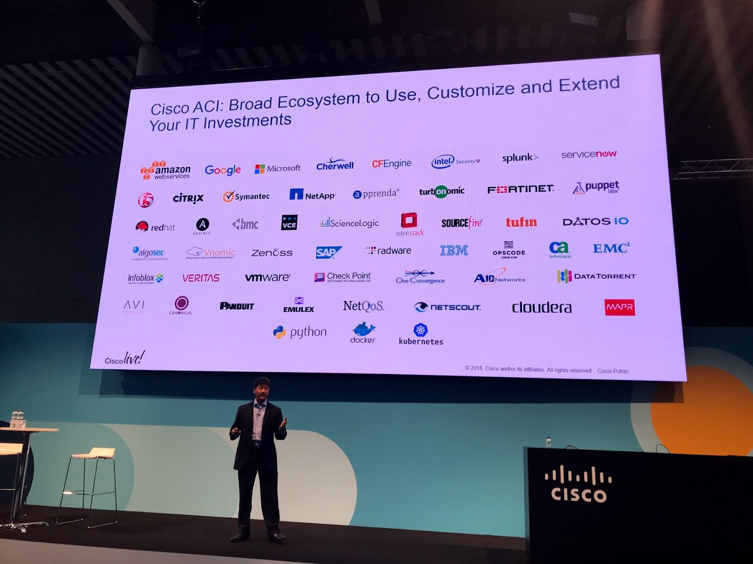

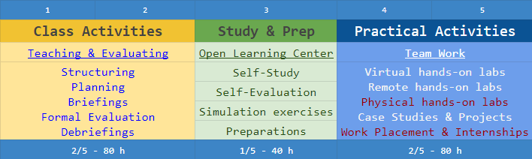
Time for Questions & Remarks
Notes:
References to learn more background information and examples you can find here

Slide 61
References
Slide Deck for This Workshop
URL: https://docs.google.com/presentation/d/1vGFxT2L7Nd7WXp8RvgApYCb3LQglFlZSWvDpFveRqqA/edit?usp=sharing
Data Files for the Practical Examples and Exercises of This Workshop
URL: https://drive.google.com/drive/folders/1Ip6nw4uxTHb5t9TxHEC3xcRPGzsTgEnH?usp=sharing
Background Document For This Workshop
URL: https://docs.google.com/document/d/1jWNaW4OMkcCu1wnXZbQSMKxy23dIcq6ds4CBnEEXe0Q/edit?usp=sharing

Slide 62

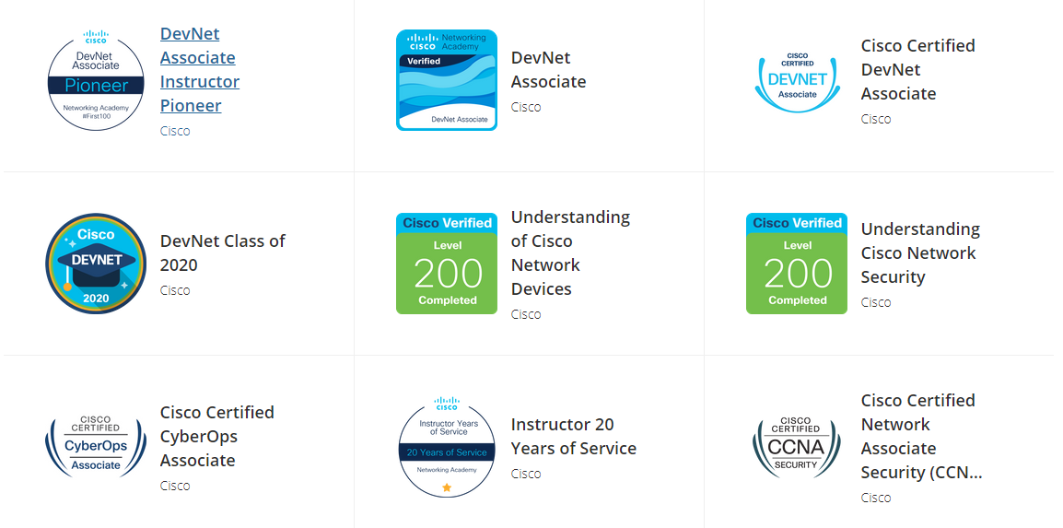
My Recent Badges
Notes:
METADATA
Author: Yvan Rooseleer
Speaker's email: Yvan Rooseleer yvan.rooseleer@biasc.be
Creation Date: 6 February 2021
Based on document: https://docs.google.com/document/d/1jWNaW4OMkcCu1wnXZbQSMKxy23dIcq6ds4CBnEEXe0Q/edit?usp=sharing
Session name:
Part 1: DevNet Associate: Filtering JSON Data, 25 FEB 2021, 16:00
Part 2: DevNet Associate: Generating JSON Data, 25 FEB 2021, 17:00
Session description:
Part 1: DevNet Associate: Filtering JSON Data
Description: This part covers some aspects of the DevNet Associate course. Join to learn how to interpret JSON data coming from Webex Teams API, DNAC API, Docker inspect, Ansible.
Part 2: DevNet Associate: Generating JSON Data
Description: This part covers some aspects of the DevNet Associate course. Join to learn how to generate JSON data for Webex Teams API, IP Devices and Network Services from a source in the Excel format.
Level: Intermediate
Prerequisites
Basic understanding of:
-- Python scripting and programming
-- Data modelling: YANG
-- Data formats: JSON, YAML, XML
-- Secure Shell/ SSH
-- HTTPS/ SSL/ TLS
-- Webex APIs
-- Restconf APIs
-- Ansible Playbooks
-- Docker

